Slide 1
Adding Properties to a JavaBean
Add animationDelay property
  Control animation speed
  Extend LogoAnimator and create LogoAnimator2
  Read/write property of bean
    Defined as set/get method pair of format:
    public void setPropertyName( DataType value )
    public DataType getPropertyName()
    Property set and get methods
    If using boolean, use isPropertyName() instead of get
  We use setAnimationDelay and getAnimationDelay

Slide 2
1 // Fig. 25.30: LogoAnimator2.java
2 // Animation bean with animationDelay property
3 package jhtp3beans;
4
5 import java.awt.*;
6 import java.awt.event.*;
7 import javax.swing.*;
8
9 public class LogoAnimator2 extends LogoAnimator {
10 // the following two methods are
11 // for the animationDelay property
12 public void setAnimationDelay( int value )
13 {
14 animationDelay = value;
Methods must follow format.
15
1. extends LogoAnimator
2. setAnimationDelay
3. getAnimationDelay
16 animationTimer.setDelay( animationDelay );
17 }
18
19 public int getAnimationDelay()
20 {
21 return animationTimer.getDelay();
22 }
23
24 public static void main( String args[] )
25 {
26 LogoAnimator2 anim = new LogoAnimator2();

Slide 3
27
28 JFrame app = new JFrame( "Animator test" );
29 app.getContentPane().add( anim, BorderLayout.CENTER );
30
31 app.addWindowListener(
32 new WindowAdapter() {
33 public void windowClosing( WindowEvent e )
34 {
35 System.exit( 0 );
36 }
37 }
38 );
39
40 app.setSize( anim.getPreferredSize().width + 10,
41 anim.getPreferredSize().height + 30 );
42 app.show();
43 }
44 }

Slide 4
Adding Properties to a JavaBean
Properties
  When builder tool examines bean, looks for pairs of set/get methods
    Introspection
    If found, used as property
Creating bean
  Must wrap LogoAnimator2 class
  Compile: javac -d . LogoAnimator2.java
  Create manifest.tmp
1 Main-Class: jhtp3beans.LogoAnimator2
2
3 Name: jhtp3beans/LogoAnimator2.class
4 Java-Bean: True

Slide 5
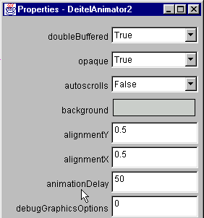
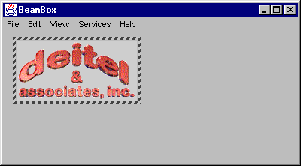
Adding Properties to a JavaBean
Creating bean
  Package into JAR file
jar cfm LogoAnimator2.jar manifest.tmp jhtp3beans\*.*
  Load LogoAnimator2 bean, can change animationDelay property

Slide 6
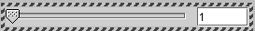
Creating a JavaBean with a Bound Property
Bound property
  Other objects notified when it changes
  Use event handling
    Registered PropertyChangeListeners notified when value changes
  java.beans package
    Class PropertyChangeEvent, PropertyChangeListener
Example
  Create custom GUI component SliderFieldPanel
    Has a JTextField linked to a JSlider
    Changes affect them both

Slide 7
Creating a JavaBean with a Bound Property
Example
  Want to link this to LogoAnimator2
    Want SliderFieldPanel to control animation speed
  Use same package
  Subclass of JPanel, can add JSlider and JTextField
3 package jhtp3beans;
12 public class SliderFieldPanel extends JPanel
13 implements Serializable {

Slide 8
Creating a JavaBean with a Bound Property
25 changeSupport = new PropertyChangeSupport( this );
  Create object
    argument (this) - source of PropertyChangeEvent
  Register ChangeListener
    When changed, calls setCurrentValue
    Notifies registered PropertyChangeListeners
40 slider.addChangeListener(
41 new ChangeListener() {
42 public void stateChanged( ChangeEvent e )
43 {
44 setCurrentValue( slider.getValue() );
45 }
46 }
47 );

Slide 9
Creating a JavaBean with a Bound Property
61 public void addPropertyChangeListener(
62 PropertyChangeListener listener )
  Help register ChangeListeners
    Supply listener interface and event class
    Must have methods for adding/removing listeners
    Use this naming for bound property events
63 {
64 changeSupport.addPropertyChangeListener( listener );
65 }
66
67 public void removePropertyChangeListener(
68 PropertyChangeListener listener )
69 {
70 changeSupport.removePropertyChangeListener( listener );
71 }

Slide 10
Creating a JavaBean with a Bound Property
106 public void setCurrentValue( int current )
107 {
  currentValue - bound property
    setCurrentValue, getCurrentValue
    When changes, must notify registered PropertyChangeListeners
  Method firePropertyChange( propertyName, oldValue, newValue );
    Of PropertyChangeSupport
    Notifies registered listeners
112 changeSupport.firePropertyChange(
113 "currentValue", new Integer( oldValue ),
114 new Integer( currentValue ) );

Slide 11
1 // Fig. 25.33: SliderFieldPanel.java
2 // A subclass of JPanel containing a JSlider and a JTextField
3 package jhtp3beans;
4
5 import javax.swing.*;
6 import javax.swing.event.*;
7 import java.io.*;
8 import java.awt.*;
9 import java.awt.event.*;
10 import java.beans.*;
11
12 public class SliderFieldPanel extends JPanel
13 implements Serializable {
14 private JSlider slider;
15 private JTextField field;
16 private Box boxContainer;
Create new object, used to register change listeners.
17 private int currentValue;
18
1. package
1.1 extends JPanel
1.2 Declarations
1.3 Constructor
1.4 PropertyChange Support
1.5 GUI
19 // object to support bound property changes
20 private PropertyChangeSupport changeSupport;
21
22 public SliderFieldPanel()
23 {
24 // create PropertyChangeSupport for bound properties
25 changeSupport = new PropertyChangeSupport( this );
26
27 slider =
28 new JSlider( SwingConstants.HORIZONTAL, 1, 100, 1 );
29 field = new JTextField(
30 String.valueOf( slider.getValue() ), 5 );

Slide 12
31
32 boxContainer = new Box( BoxLayout.X_AXIS );
33 boxContainer.add( slider );
34 boxContainer.add( Box.createHorizontalStrut( 5 ) );
35 boxContainer.add( field );
36
37 setLayout( new BorderLayout() );
38 add( boxContainer );
39
40 slider.addChangeListener(
41 new ChangeListener() {
42 public void stateChanged( ChangeEvent e )
43 {
44 setCurrentValue( slider.getValue() );
45 }
Call method setCurrentValue when value changes.
46 }
47 );
1.6 Event handlers
48
49 field.addActionListener(
50 new ActionListener() {
51 public void actionPerformed( ActionEvent e )
52 {
53 setCurrentValue(
54 Integer.parseInt( field.getText() ) );
55 }
56 }
57 );
58 }
59

Slide 13
60 // methods for adding and removing PropertyChangeListeners
61 public void addPropertyChangeListener(
62 PropertyChangeListener listener )
63 {
64 changeSupport.addPropertyChangeListener( listener );
65 }
66
Methods to support registration. Methods must have this naming.
67 public void removePropertyChangeListener(
68 PropertyChangeListener listener )
69 {
70 changeSupport.removePropertyChangeListener( listener );
71 }
72
73 // property minimumValue
74 public void setMinimumValue( int min )
75 {
76 slider.setMinimum( min );
2. addPropertyChange Listener
3. removeProperty ChangeListener
77
78 if ( slider.getValue() < slider.getMinimum() ) {
79 slider.setValue( slider.getMinimum() );
80 field.setText( String.valueOf( slider.getValue() ) );
81 }
82 }
83
84 public int getMinimumValue()
85 {
86 return slider.getMinimum();
87 }
88

Slide 14
89 // property maximumValue
90 public void setMaximumValue( int max )
91 {
92 slider.setMaximum( max );
93
94 if ( slider.getValue() > slider.getMaximum() ) {
95 slider.setValue( slider.getMaximum() );
96 field.setText( String.valueOf( slider.getValue() ) );
97 }
98 }
99
100 public int getMaximumValue()
101 {
102 return slider.getMaximum();
103 }
104
105 // property currentValue
106 public void setCurrentValue( int current )
107 {
4. setCurrentValue
4.1 firePropertyChange
5. getCurrentValue
108 int oldValue = currentValue;
109 currentValue = current;
Pass name, old value, and new value. This notifies registered listeners of change.
110 slider.setValue( currentValue );
111 field.setText( String.valueOf( currentValue ) );
112 changeSupport.firePropertyChange(
113 "currentValue", new Integer( oldValue ),
114 new Integer( currentValue ) );
115 }
116
117 public int getCurrentValue()
118 {
119 return slider.getValue();
120 }

Slide 15
121
122 // property fieldWidth
123 public void setFieldWidth( int cols )
124 {
125 field.setColumns( cols );
126 boxContainer.validate();
127 }
128
129 public int getFieldWidth()
130 {
131 return field.getColumns();
132 }
133
134 public Dimension getMinimumSize()
135 {
136 return boxContainer.getMinimumSize();
137 }
138
6. set/get methods
139 public Dimension getPreferredSize()
140 {
141 return boxContainer.getPreferredSize();
142 }
143 }

Slide 16
Creating a JavaBean with a Bound Property
Create bean
  Compile: javac -d . SliderFieldPanel.java
  Manifest file (manifest.tmp)
    No Main-Class: because not an application
  Archive in JAR file:
jar cfm SliderFieldPanel.jar manifest.tmp jhtp3beans\*.*
1 Name: jhtp3beans/SliderFieldPanel.class
2 Java-Bean: True

Slide 17
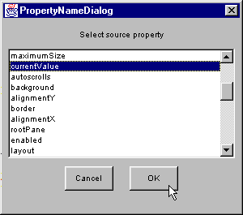
Creating a JavaBean with a Bound Property
Usage
  Add SliderFieldPanel to BeanBox with Juggler
    Set maximumValue to 1000, currentValue to 125 (default animations speed for Juggler)
  Go to Edit->Bind property...
    Click currentValue

Slide 18
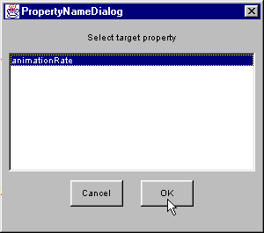
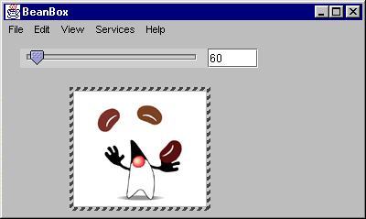
Creating a JavaBean with a Bound Property
Usage
  Red target selector line appears
    Connect to Juggler and click
  PropertyNameDialog
    Shows target properties with same data type as bound property
    Select animationRate (only listed property)
    animationRate bound to currentValue

Slide 19
Specifying the BeanInfo Class for a JavaBean
Introspection mechanism
  Used by builder tool
  Exposes bean's properties, methods, and events if programmer uses design patterns
    I.e., special naming conventions
  Use classes in java.lang.reflect for introspection
  Can customize which methods/events/properties available
    Create class that implements interface BeanInfo
    BeanInfo class has same name as bean, ends in BeanInfo
      SliderFieldPanelBeanInfo.java
    Placed in same package as bean

Slide 20
Specifying the BeanInfo Class for a JavaBean
7 public class SliderFieldPanelBeanInfo extends SimpleBeanInfo {
  SimpleBeanInfo
    Default implementation of BeanInfo
    Selectively override methods
  Class Class
    Allows program to refer to class definition
    Refers to class that will be searched for features described in beanInfo class
    final - will not be modified
    static - only one instance needed
8 public final static Class beanClass =
9 SliderFieldPanel.class;

Slide 21
Specifying the BeanInfo Class for a JavaBean
11 public PropertyDescriptor[] getPropertyDescriptors()
12 {
  getPropertyDescriptors (overridden)
    Returns array of PropertyDescriptor objects
      Each describes property
  new PropertyDescriptor( "propertyName", beanClass )
    Property must have named set and get methods
  setBound( true )
    Specifies property is bound
14 PropertyDescriptor fieldWidth =
15 new PropertyDescriptor( "fieldWidth", beanClass );
26 currentValue.setBound( true );

Slide 22
Specifying the BeanInfo Class for a JavaBean
39 public int getDefaultPropertyIndex()
40 {
  getDefaultPropertyIndex (overridden)
    Returns array index of default property
    In this case, currentValue
  getEventSetDescriptors
    Returns array of EventSetDescriptor objects
    Describes events supported by bean
41 return 1;
42 }
44 public EventSetDescriptor[] getEventSetDescriptors() {

Slide 23
Specifying the BeanInfo Class for a JavaBean
46 EventSetDescriptor changed =
47 new EventSetDescriptor( beanClass,
  Constructor arguments
    1: Class object, represents event source
    2: String, event set name
      mouse includes mousePressed, mouseClicked...
      We use propertyChange
    3: Class object, implemented event listener interface
      Creates anonymous object of class
    4: String, name of listener method called when event occurs
48 "propertyChange",
49 java.beans.PropertyChangeListener.class,
50 "propertyChange");

Slide 24
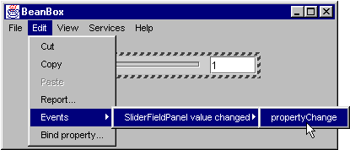
Specifying the BeanInfo Class for a JavaBean
52 changed.setDisplayName(
53 "SliderFieldPanel value changed" );
  Class EventSetDescriptor
  Method setDisplayName( stringName )
    Specifies name for event set in builder tool

Slide 25
1 // Fig. 25.38: SliderFieldPanelBeanInfo.java
Same package as bean.
Extend SimpleBeanInfo class, with default implementation of BeanInfo interface.
2 // The BeanInfo class for SliderFieldPanel
3 package jhtp3beans;
4
5 import java.beans.*;
6
7 public class SliderFieldPanelBeanInfo extends SimpleBeanInfo {
8 public final static Class beanClass =
Create Class object, provides access to class definition.
9 SliderFieldPanel.class;
Specify properties that can be exposed by builder.
10
11 public PropertyDescriptor[] getPropertyDescriptors()
12 {
13 try {
14 PropertyDescriptor fieldWidth =
15 new PropertyDescriptor( "fieldWidth", beanClass );
16 PropertyDescriptor currentValue =
1. package
1.1 import
1.2 extends SimpleBeanInfo
1.3 Class
2. getProperty Descriptors
2.1 setBound
17 new PropertyDescriptor(
18 "currentValue", beanClass );
19 PropertyDescriptor maximumValue =
20 new PropertyDescriptor(
21 "maximumValue", beanClass );
22 PropertyDescriptor minimumValue =
23 new PropertyDescriptor( "minimumValue", beanClass );
Specify bound property.
24
25 // ensure PropertyChangeEvent occurs for this property
26 currentValue.setBound( true );
27

Slide 26
28 PropertyDescriptor descriptors[] = { fieldWidth,
29 currentValue, maximumValue, minimumValue };
30
31 return descriptors;
32 }
33 catch ( IntrospectionException ie ) {
34 throw new RuntimeException( ie.toString() );
Get array index of default property (currentValue).
35 }
36 }
37
38 // the index for the currentValue property
39 public int getDefaultPropertyIndex()
40 {
41 return 1;
42 }
43
44 public EventSetDescriptor[] getEventSetDescriptors() {
3. getDefaultProperty Index
4. getEventSet Descriptors
4.1 Constructor
4.2 setDisplayName
Describes events supported by bean.
45 try {
46 EventSetDescriptor changed =
47 new EventSetDescriptor( beanClass,
48 "propertyChange",
49 java.beans.PropertyChangeListener.class,
50 "propertyChange");
Set title of event in builder.
51
52 changed.setDisplayName(
53 "SliderFieldPanel value changed" );
54
55 EventSetDescriptor[] descriptors = { changed };

Slide 27
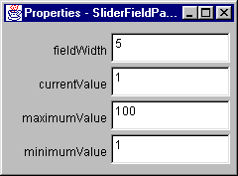
56
57 return descriptors;
58 }
59 catch (IntrospectionException e) {
60 throw new RuntimeException(e.toString());
61 }
62 }
63 }
Program Output
Only the specified properties are listed.

Slide 28
JavaBeans World Wide Web Resources
Web resources
  http://java.sun.com/beans/
    Download Beans Development Kit, docs
  http://java.sun.com/beans/spec.html
    Specifications
  http://java.sun.com/beans/tools.html
    Beans-enabled development tools
  http://java.sun.com/beans/directory/
    Searchable directory of beans
  http://java.sun.com/products/hotjava/bean/
  index.html
    Evaluation version of bean with HTML rendering

